Slide 1
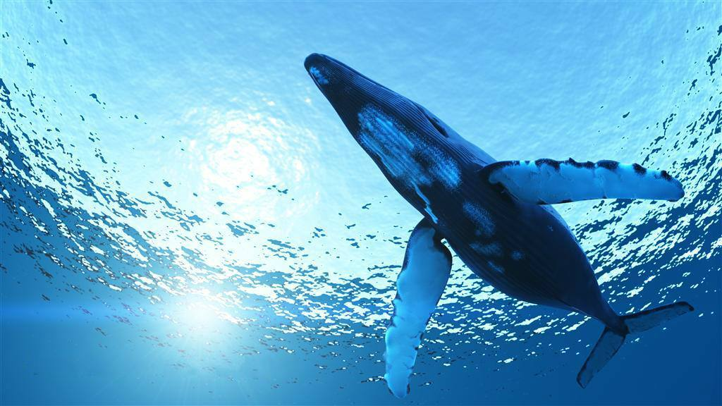
The Blue Whale
Beautiful and rare creatures in the sea
HPCX73602 Karl 1.2

Slide 2
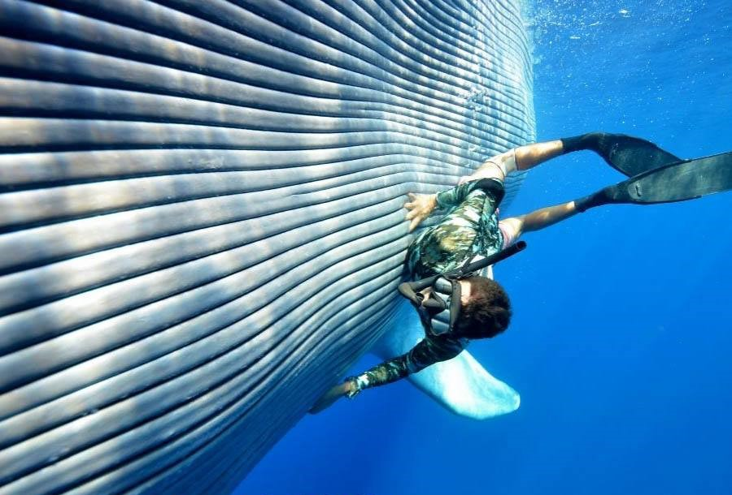
Table of contents
The bodyshape of blue whale
Habitat and diet of them
Different evolutionary direction from others
Before being protected

Slide 3
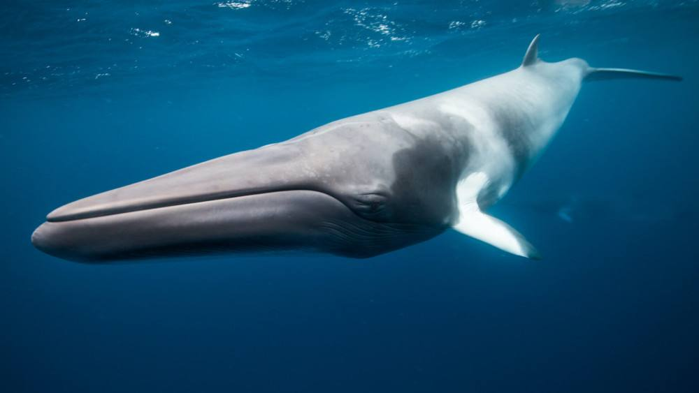
The bodyshape of blue whale
The largest animal ever
Special skin
swimming speed

Slide 4
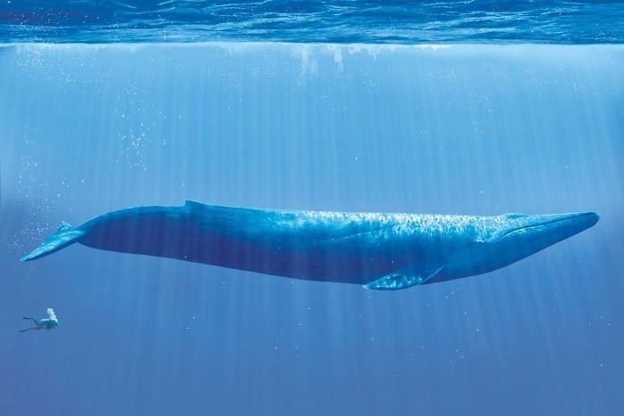

Slide 5
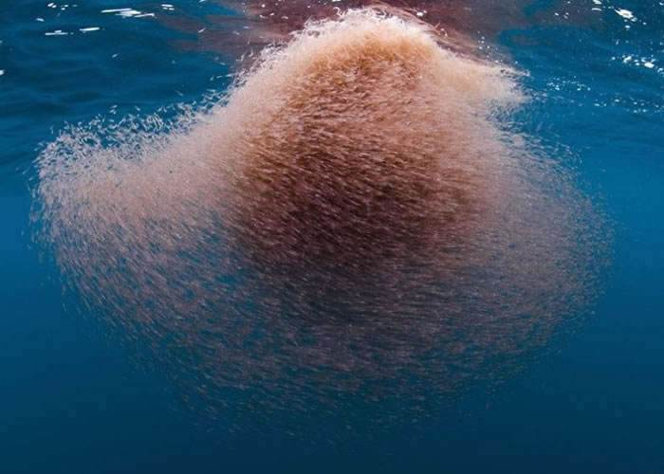
Habitat and diet of them
The krill in the Antarctic Ocean
Around the world， but most of them are living in the Antarctic Ocean

Slide 6
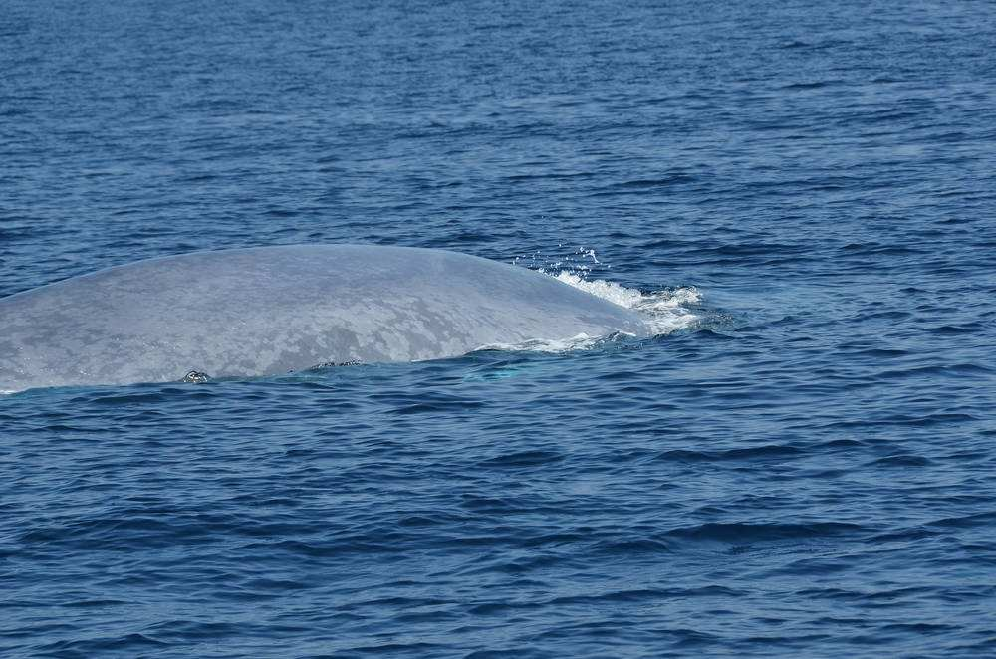
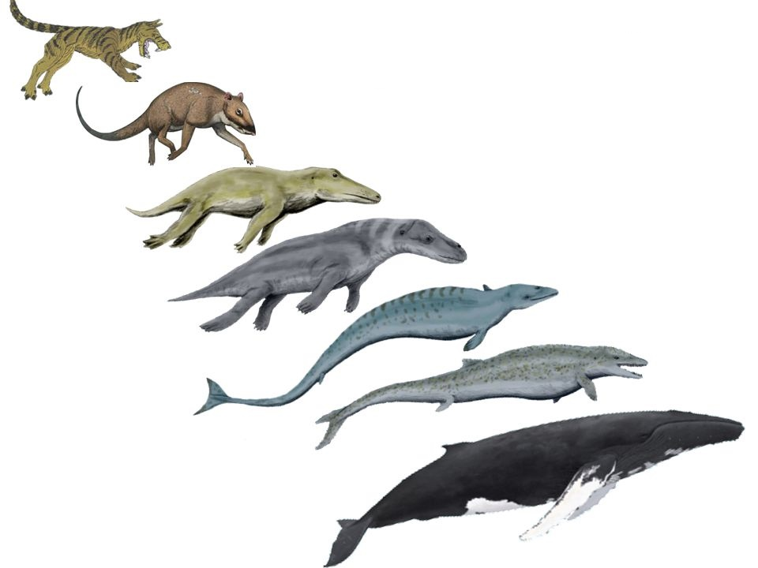
Different evolutionary direction from others
Was land animal thousands of years ago
Becomes aquatic animal again now

Slide 7
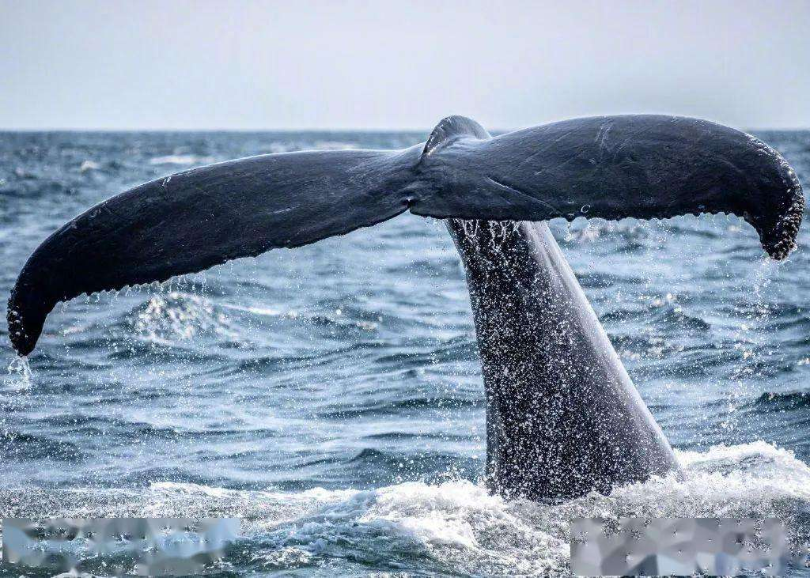
Before being protected
Hunting them for their fat
More than 300,000 whales be killed
Down to 1,000 whales in the world

Slide 8
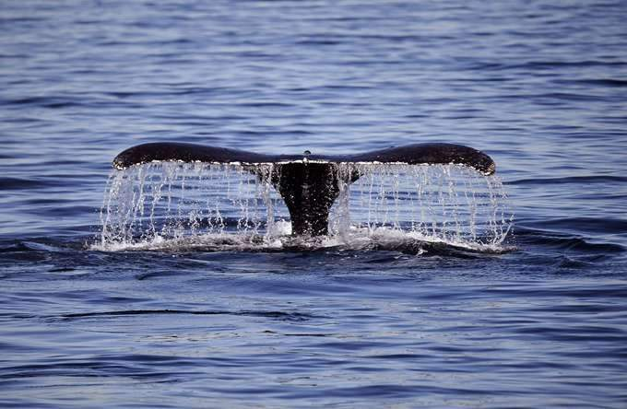
Reference
“Blue whale_Baidu baike.” Baidu baike, https://baike.baidu.com/item/%E8%93%9D%E9%B2%B8/85498?fr=aladdin.

